Slide 1
C++ exception handling

Slide 2
What is an exception?
Problem that occurs during the execution of a program
Response to an exceptional circumstance
Handle it
Disrupt the normal flow of instructions

Slide 3
Key phrases
Exception
Throw
Catch
Try

Slide 4
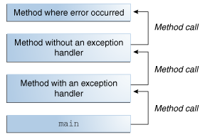
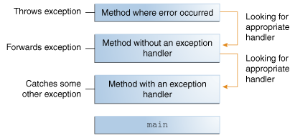

Slide 5
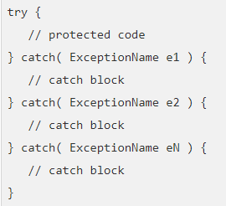

Slide 6
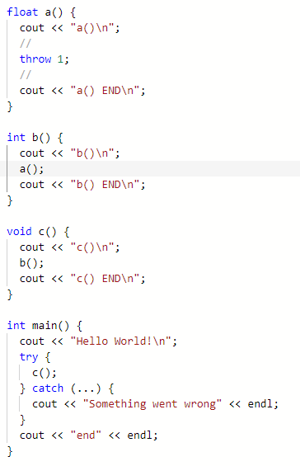
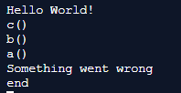

Slide 7
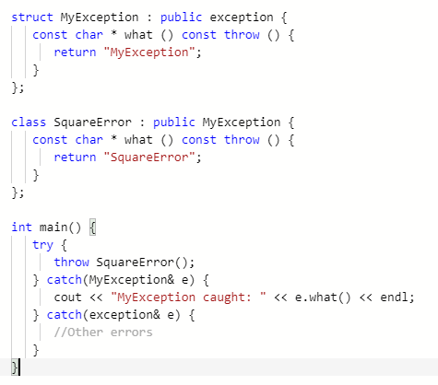
What does this print?

Slide 8

What does this print?

Slide 9
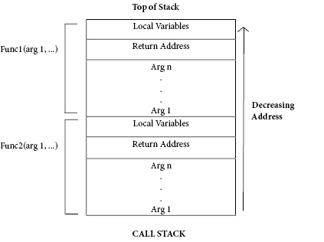
How do exceptions actually work?
Call Stack
Stack – LIFO
The call stack supports functions calls and the return statement
Each time a function is called an entry is pushed onto the call stack
This is the stack frame contains the return address that called the function

Slide 10
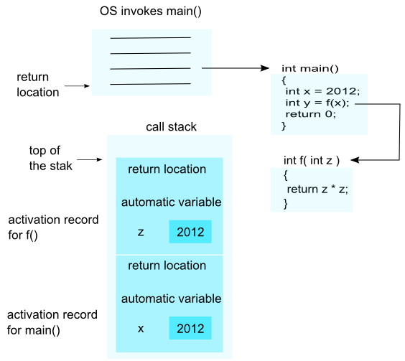

Slide 11
Stack unwinding
Stack contains the return address
Function completes – what instruction is next?
Look at the return address
Arguments are automatic variables
As are local variables (mostly)
Function terminates
The stack frame is popped, or freed
Automatic variables are therefore freed
Class destructors are called

Slide 12
Exception thrown
Exception thrown
Unwind stack
Unlike normal, we don’t stop at the first return address
We look for an address that resides within a try block
Execution then passes to the exception handlers
Note – variables are freed
Note – object destructors are called

Slide 13
Tasks
Research stack overflow
Read up on exceptions (c++ exceptions under the hood)
Complete the HTML classes
Add exceptions, e.g. a <p> can NOT contain a <div>
Raise an appropriate exception
Live code?

